Slide 1
Database Connectivity with Python
By Dr Shantanu Pathak

Slide 2
Python and DB Connectivity
Supports DB which fulfill Python DB API V2.0 standards
Oracle
MySQL
SQLite
MSSQL , etc
Stored procedures are supported ( as per DB)
Multi Threading Supported (as per the DB)
Support is primitive and version changes affect the working

Slide 3
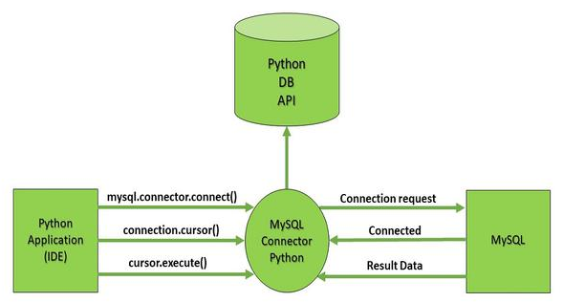
Python Connector to DB (MySQL)

Slide 4
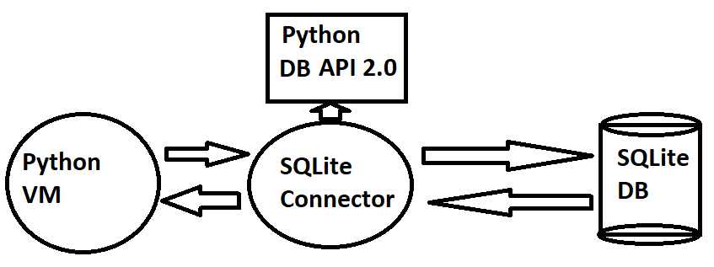
Python Connector to DB (SQLite )

Slide 5
Python to DB steps
Step 1: Connect
Connect to a database
Name of DB, hostname, user, password
Sends connection request
If successful, then connection object is returned
Connection object establishes connection with the DB
Step 2: Cursor
Cursor object is used to execute the queries
Cursor can store the results of queries

Slide 6
Python to DB steps
Step 3: Execute
Cursor uses execute function
Used to execute the queries
Step 4: Commit
Commit the changes in DB
Step 5: Close
Close the connection object

Slide 7
Python DB Example MySQL
from mysql.connector import connect
con = connect()
cur = con.cursor()
cur.execute(“select * …”)
con.commit()
con.close()

Slide 8
Python DB Example SQLite
Import sqlite3
conn = sqlite3.connect('test.db')
cur = conn.cursor()
cur.execute(“create table …”)
conn.commit()
conn.close()

Slide 9
Python DB Errors and Exceptions (Any DB)
InterfaceError Errors related to the database interface, but not database itself.
DatabaseError Errors related to the database itself.
DataError Errors related to the processed data.
For example, bad type conversions, division by zero, etc.
OperationalError Errors related to the operation of the database itself.
For example, a lost connection.
IntegrityError Error when relational integrity of the database is broken.
InternalError Internal error in the database.
For example, if a stale cursor.
ProgrammingError Errors in SQL queries.
NotSupportedError Error for methods in the database API that aren’t supported by the underlying database

Slide 10
MySQL Data Base

Slide 11
MySQL
MySQL is open source database
Popular in industry
It gives great performance compared with many other DBs
Requires less memory
Administration is easier compared to other well known DBs

Slide 12
SQLite Data Base (EXTRA)

Slide 13
SQLite
Simple for operation
Light DB
No need of extensive 3rd party tools
Works over simple file system
Comes with Python ecosystem
Limitation:
Limited performance
Not for high end applications

Slide 14
SQLite
Operations are like any other relational database
Details of All the tables created is stored in
sqlite_schema or sqlite_master table
Schema contains
tables
Indexes
Views
Triggers

Slide 15
SQLite Data Type conversions
Python type | SQLite type
None | NULL
int | INTEGER
float | REAL
str | TEXT
bytes | BLOB

Slide 16
SQLite Important Functions
Connect( database)
Connect with Db and return connection object
complete_statement(statement)
Check if given string is complete SQL statement or not

Slide 17
IMP Functions of Connection Object
cursor()
Return cursor for executing the SQL statements
commit()
close()
execute()
Internally create a cursor object and call execute function on that cursor
total_changes
Return number of DB rows affected since connection is opened

Slide 18
IMP functions of cursor object
execute()
Execute given query
fetchone()
Return None if empty
Return next row using tuple
NOTE: Cursor can directly be used with for loop
for row in cur.execute(“Select * from myTable”):
print(row)

Slide 19
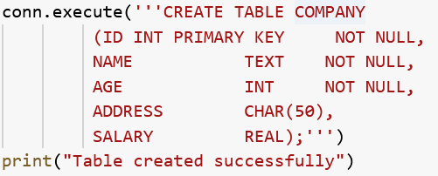
Example of queries

Slide 20
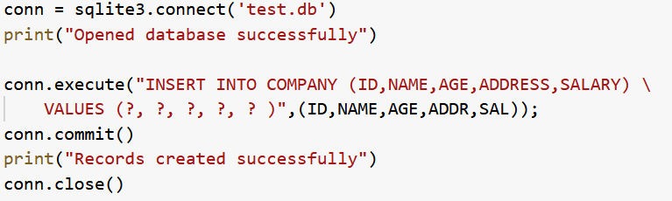
Example of queries

Slide 21
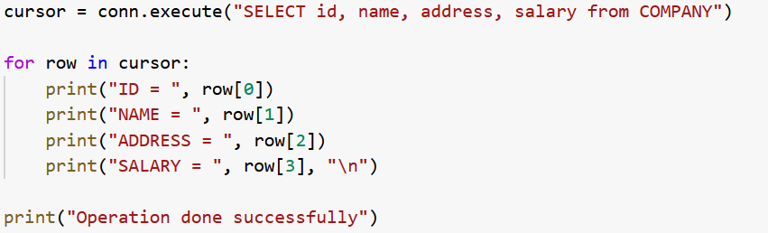
Example of queries

